Slide 1
MET CS 555 – Foundations of Machine Learning Lecture 4: T-test, One and Two sample tests
Hongsheng Wu
Boston University

Slide 2
Study Guide
T-test
Two-sample problems
R Commands for Numerical Summaries

Slide 3
t-test

Slide 4
Test of Significance (hypothesis test)
There are 5 key steps in carrying out any significance test:
1. Set up the hypotheses and select the alpha level
2. Select the appropriate test statistic
3. State the decision rule
4. Compute the test statistic and the associated p-value
5. State your conclusion

Slide 5
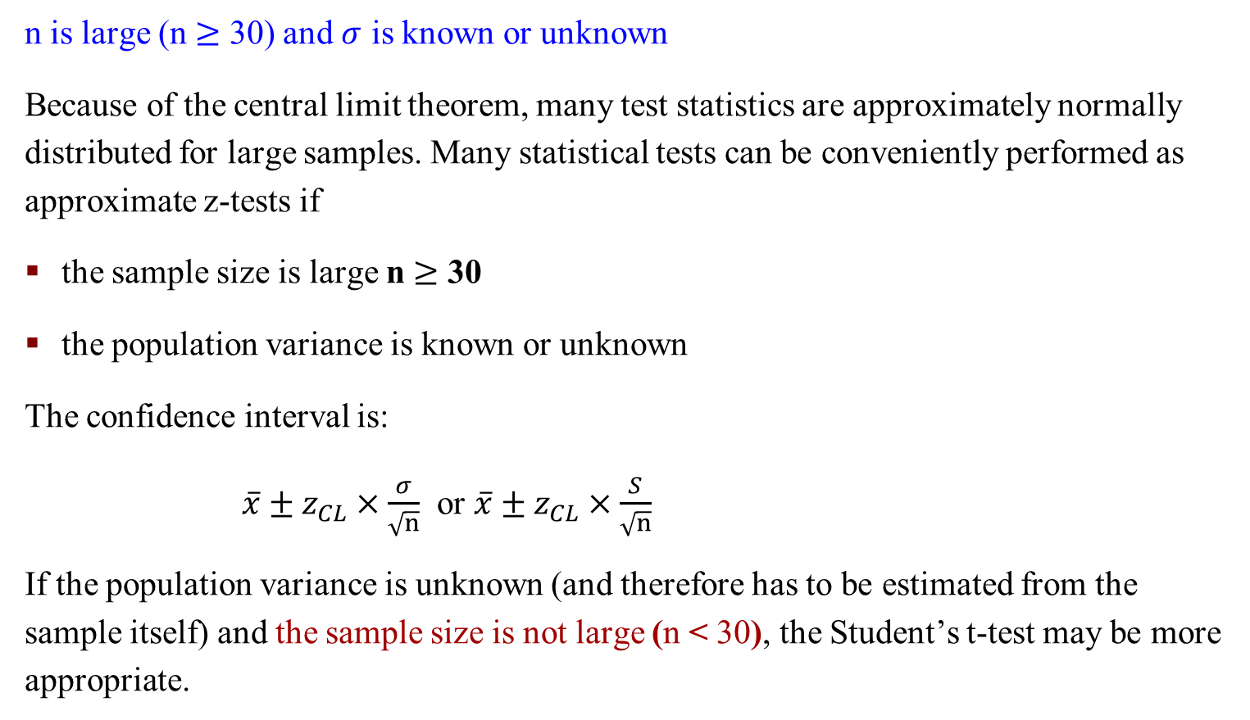
z-test
n is large (n $≥$ 30) and $σ$ is known or unknown
Because of the central limit theorem, many test statistics are approximately normally distributed for large samples. Many statistical tests can be conveniently performed as approximate z-tests if
the sample size is large n $≥$ 30
the population variance is known or unknown
The confidence interval is:
$\overline{x}±z_{CL}×\frac{σ}{\sqrt{n}}$ or $\overline{x}±z_{CL}×\frac{S}{\sqrt{n}}$
If the population variance is unknown (and therefore has to be estimated from the sample itself) and the sample size is not large (n < 30), the Student’s t-test may be more appropriate.

Slide 6

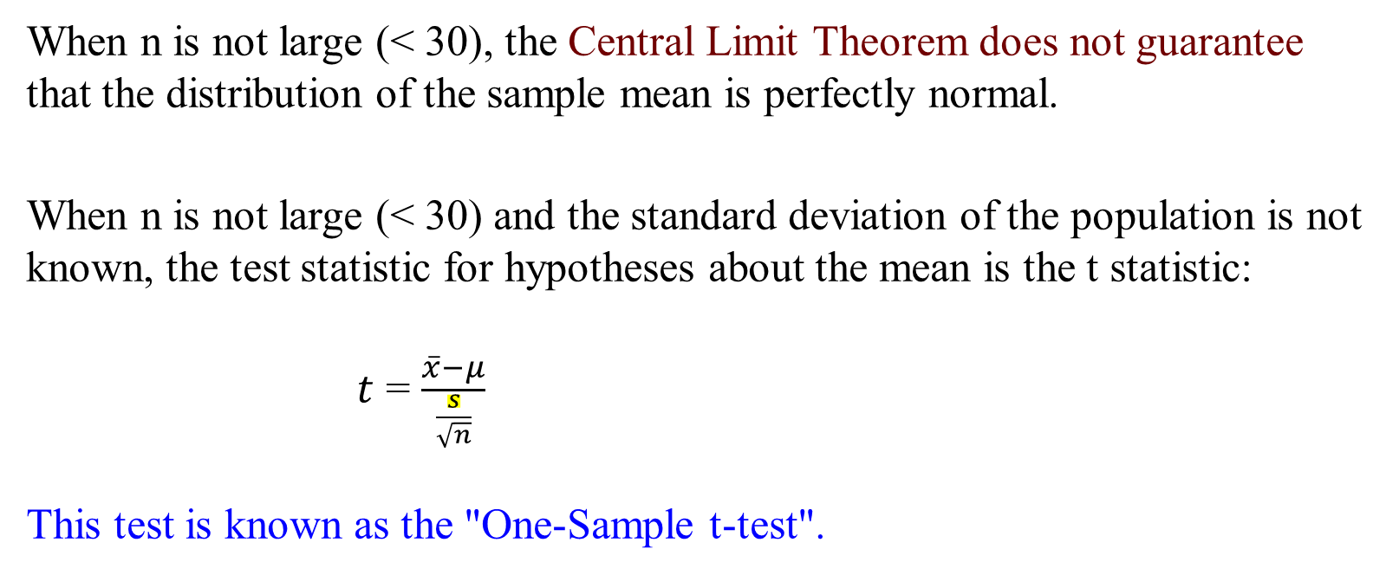
n is small (<30) and $σ$ is unknown
When n is not large (< 30), the Central Limit Theorem does not guarantee that the distribution of the sample mean is perfectly normal.
When n is not large (< 30) and the standard deviation of the population is not known, the test statistic for hypotheses about the mean is the t statistic:
$t$ = $\frac{\overline{x}−μ}{\frac{s}{\sqrt{n}}}$
This test is known as the "One-Sample t-test".
Notes:
One-sample means one population
Two-samples to compare two populations

Slide 7
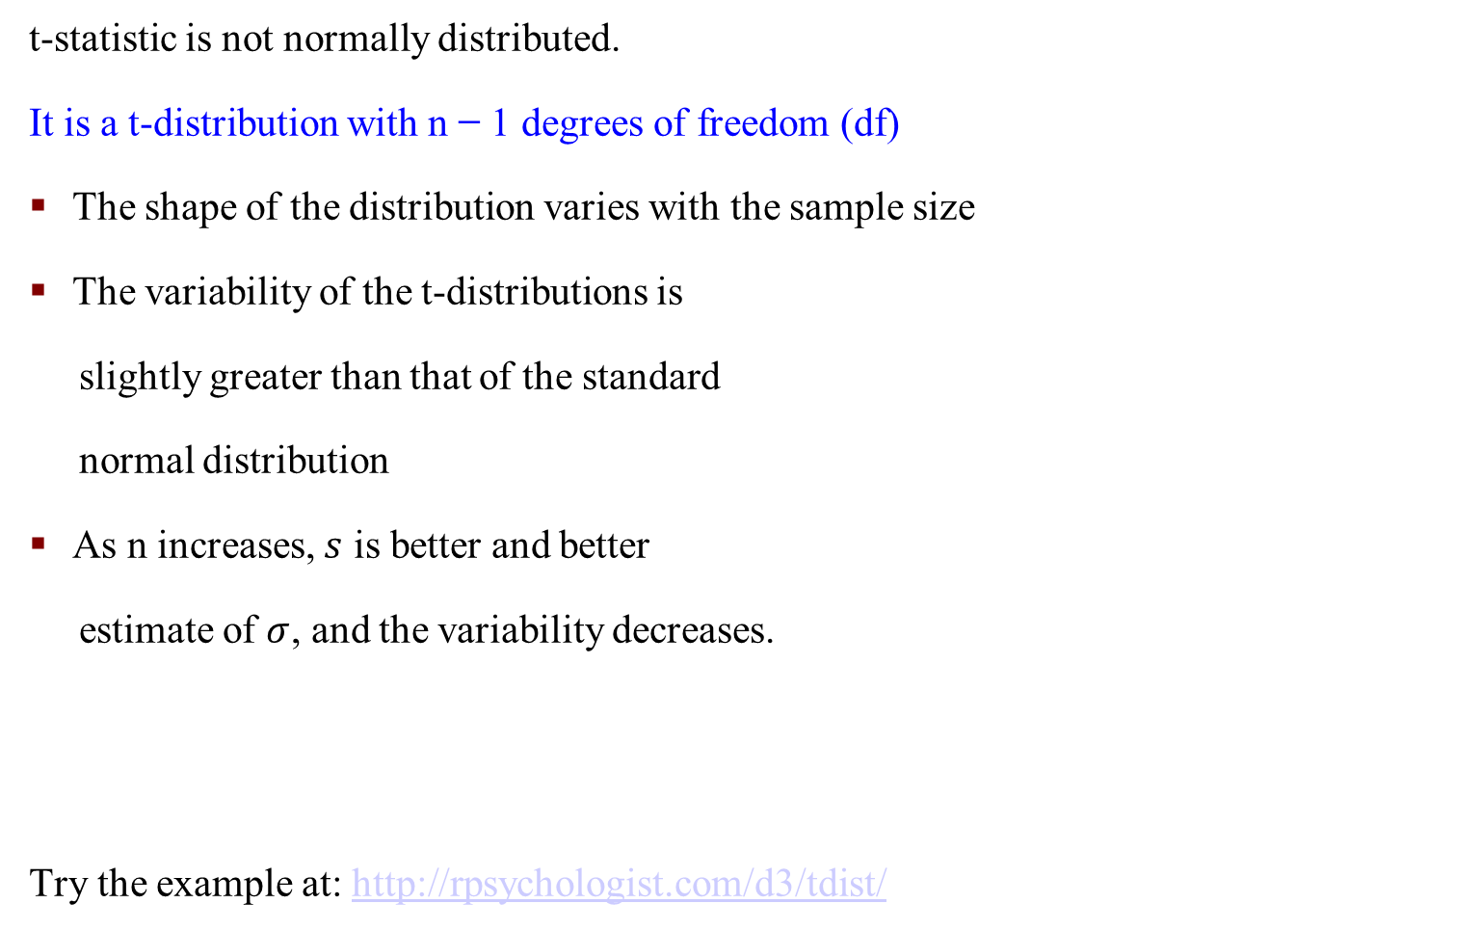
t-statistic, t-distribution
t-statistic is not normally distributed.
It is a t-distribution with n − 1 degrees of freedom (df)
The shape of the distribution varies with the sample size
The variability of the t-distributions is
slightly greater than that of the standard
normal distribution
As n increases, $s$ is better and better
estimate of $σ$, and the variability decreases.
Try the example at: http://rpsychologist.com/d3/tdist/
Notes:
n is the # of samples

Slide 8
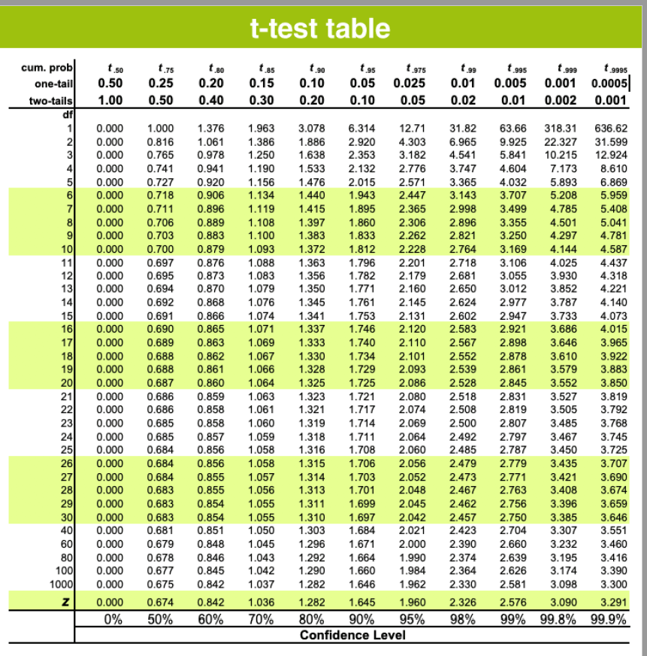
t-distribution Critical Values based on df and Confidence Level C

Slide 9
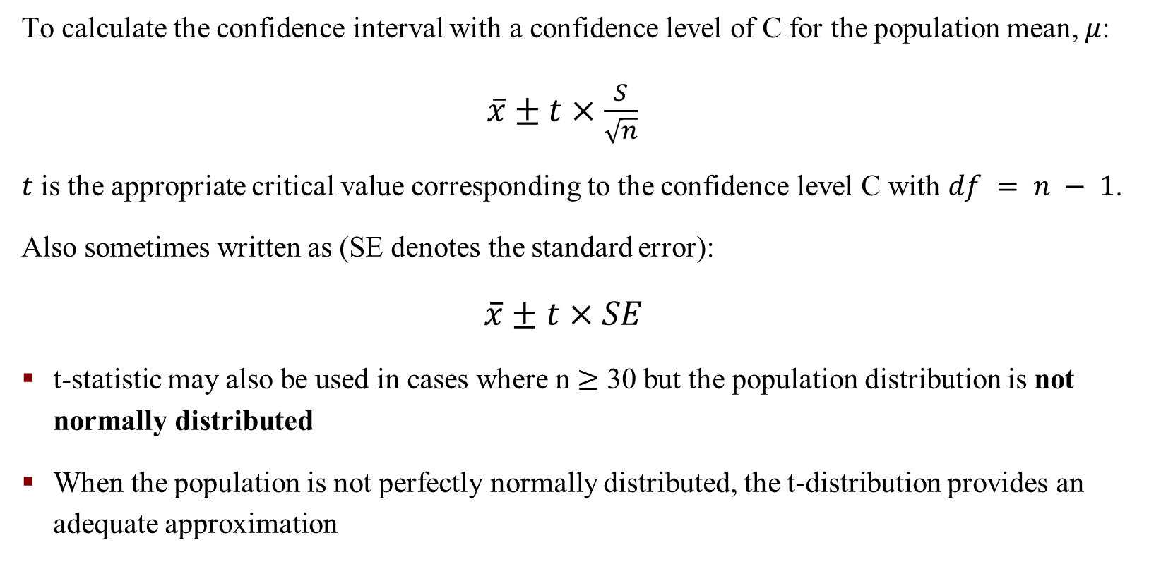
Confidence Interval in t-statistic
To calculate the confidence interval with a confidence level of C for the population mean, $μ$:
$\overline{x}±t×\frac{S}{\sqrt{n}}$
$t$ is the appropriate critical value corresponding to the confidence level C with $df = n − 1$.
Also sometimes written as (SE denotes the standard error):
$$\overline{x}±t×SE$$
t-statistic may also be used in cases where n $≥$ 30 but the population distribution is not normally distributed
When the population is not perfectly normally distributed, the t-distribution provides an adequate approximation

Slide 10
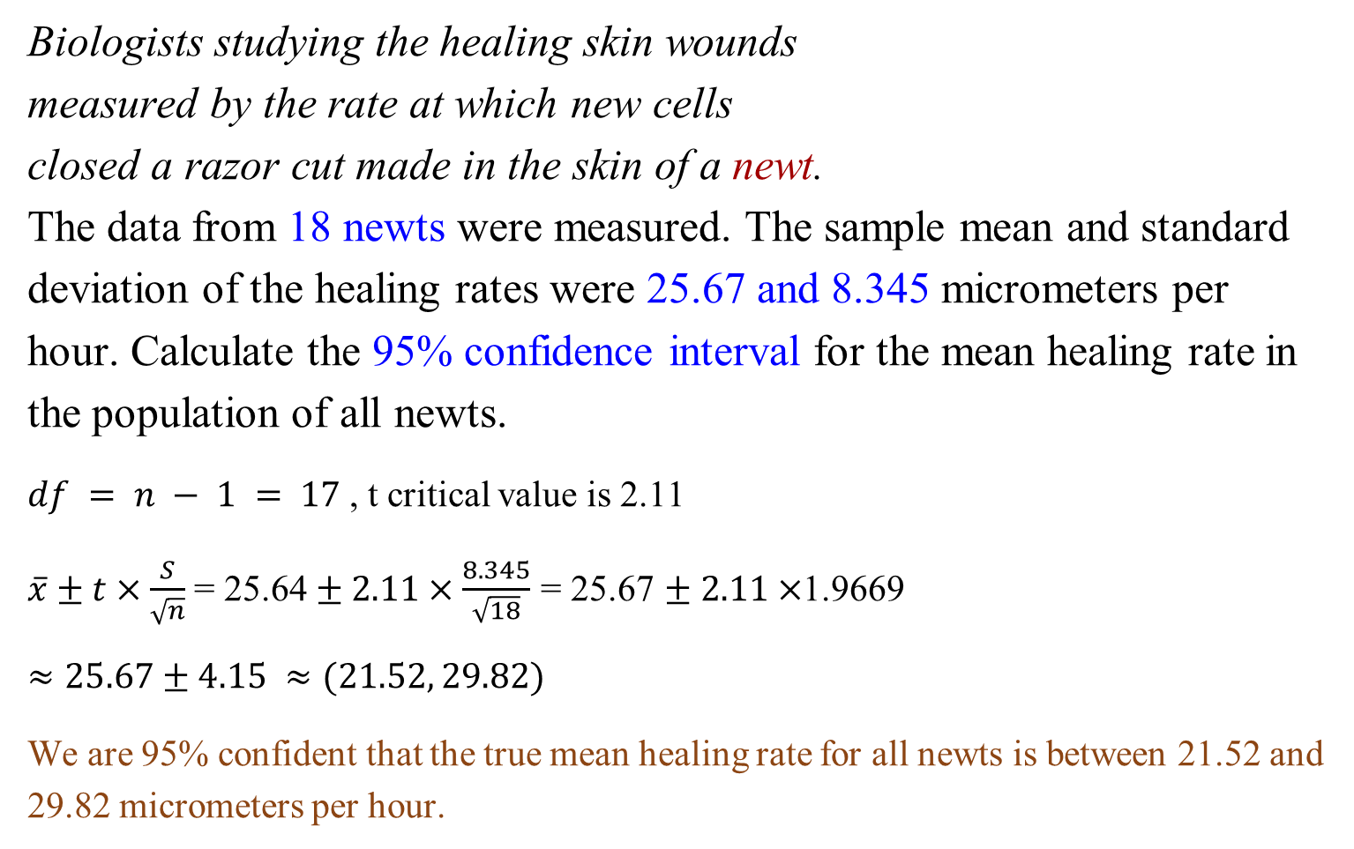
t-statistic: An Example
Biologists studying the healing skin wounds
measured by the rate at which new cells
closed a razor cut made in the skin of a newt.
The data from 18 newts were measured. The sample mean and standard deviation of the healing rates were 25.67 and 8.345 micrometers per hour. Calculate the 95% confidence interval for the mean healing rate in the population of all newts.
$df = n − 1 = 17$, t critical value is 2.11
$\overline{x}±t×\frac{S}{\sqrt{n}}$ = 25.64 $± 2.11×\frac{8.345}{\sqrt{18}}$ = 25.67 $± 2.11×$1.9669
$$≈25.67±4.15 ≈(21.52, 29.82)$$
We are 95% confident that the true mean healing rate for all newts is between 21.52 and 29.82 micrometers per hour.

Slide 11
p-value Calculation in t-statistic - One-sided
p-value calculation in t-statistic - Two-sided

Slide 12
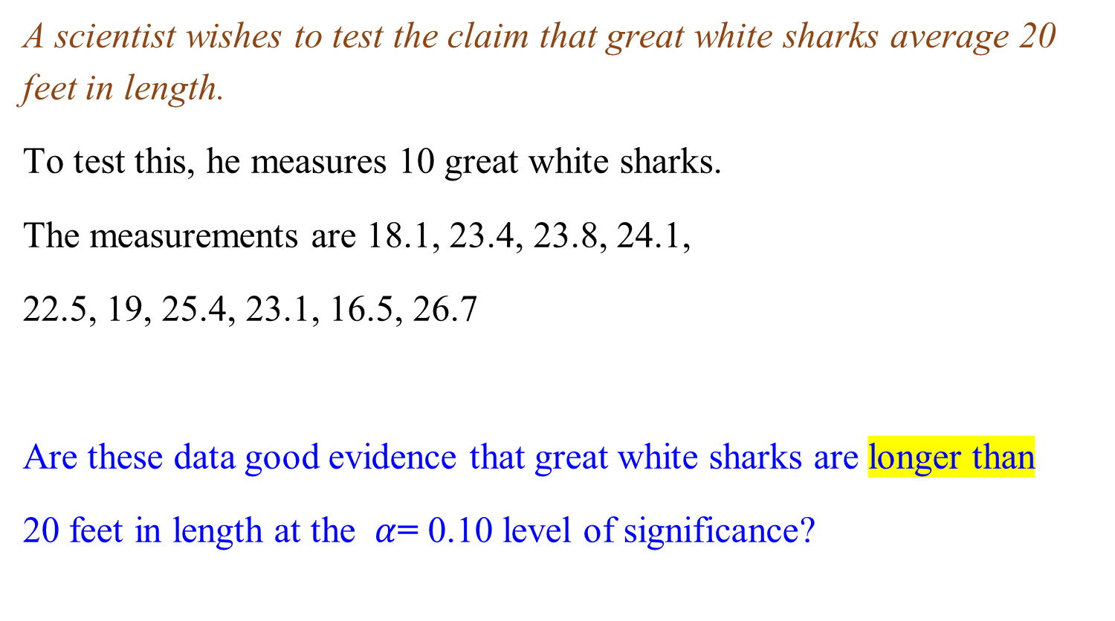
t-statistic – a One-sided Example
A scientist wishes to test the claim that great white sharks average 20 feet in length.
To test this, he measures 10 great white sharks.
The measurements are 18.1, 23.4, 23.8, 24.1,
22.5, 19, 25.4, 23.1, 16.5, 26.7
Are these data good evidence that great white sharks are longer than
20 feet in length at the $α$= 0.10 level of significance?

Slide 13
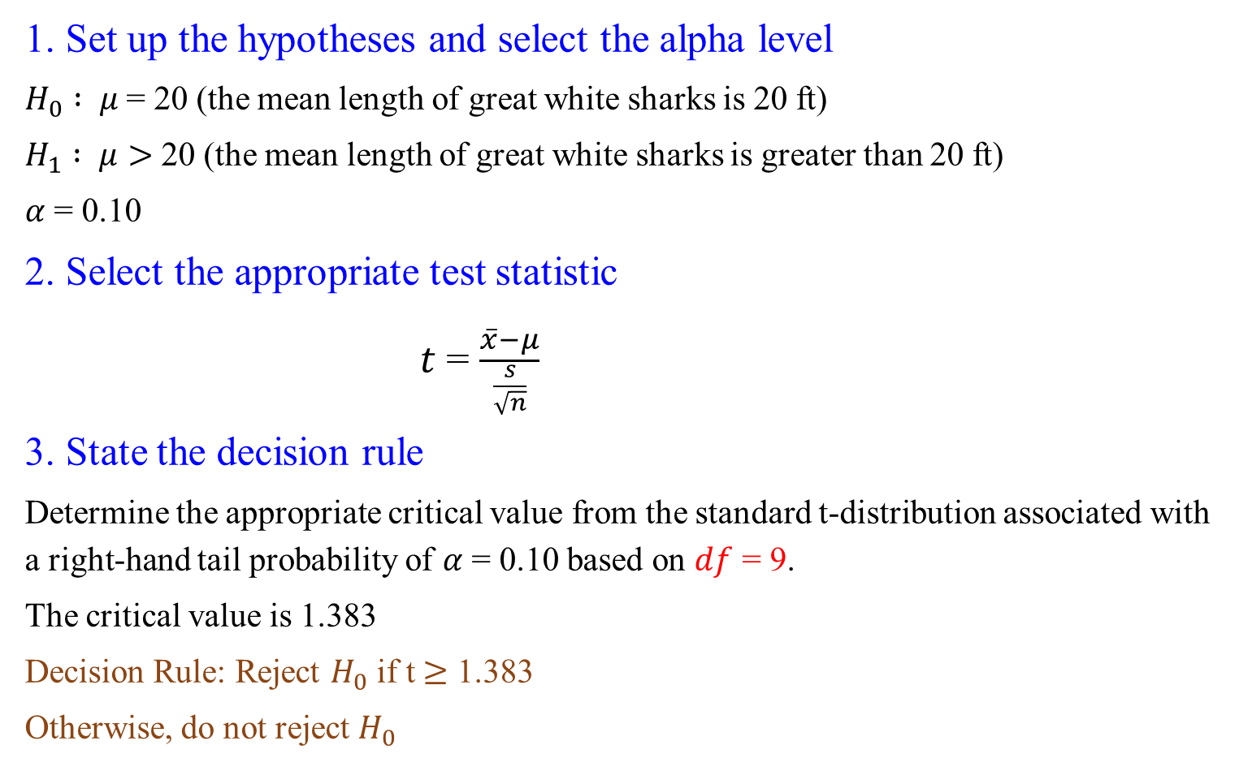
t-statistic – a one-sided example
1. Set up the hypotheses and select the alpha level
$H_{0} : μ$= 20 (the mean length of great white sharks is 20 ft)
$H_{1} : μ>$ 20 (the mean length of great white sharks is greater than 20 ft)
$α$ = 0.10
2. Select the appropriate test statistic
$t$ = $\frac{\overline{x}−μ}{\frac{s}{\sqrt{n}}}$
3. State the decision rule
Determine the appropriate critical value from the standard t-distribution associated with a right-hand tail probability of $α$ = 0.10 based on $df$ = 9.
The critical value is 1.383
Decision Rule: Reject $H_{0}$ if t $≥$ 1.383
Otherwise, do not reject $H_{0}$

Slide 14
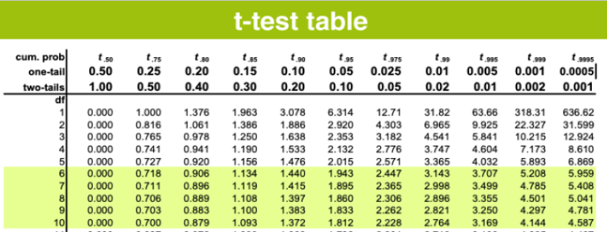
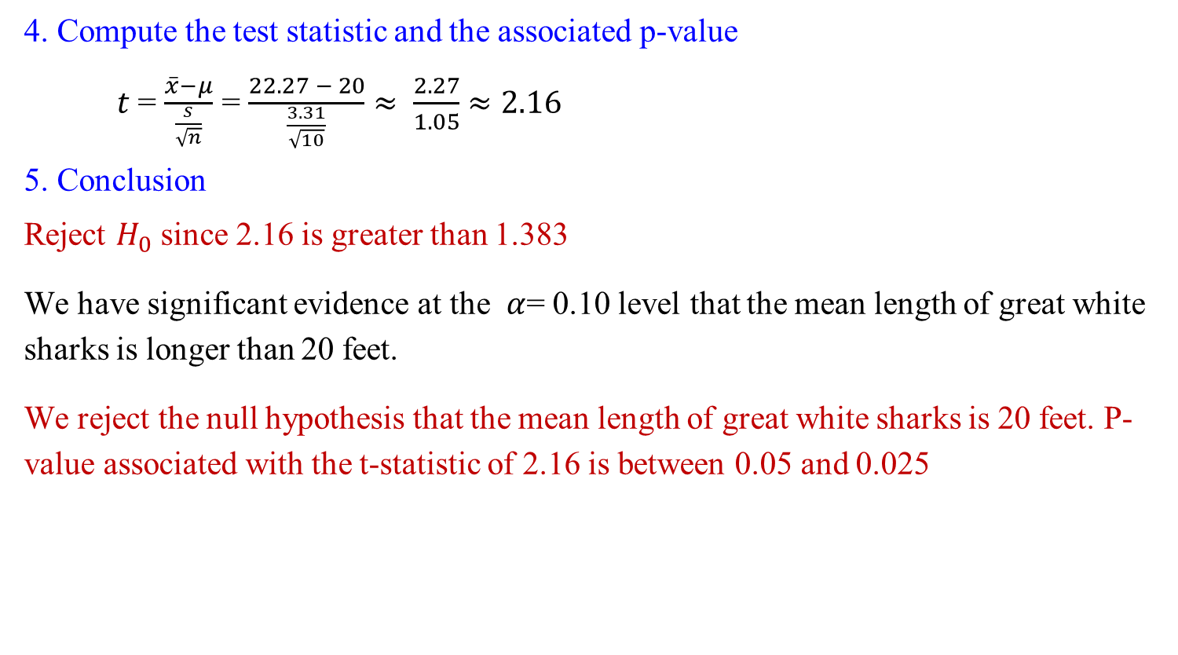
t-statistic – a One-sided Example
4. Compute the test statistic and the associated p-value
$t$ = $\frac{\overline{x}−μ}{\frac{s}{\sqrt{n}}}$ = $\frac{22.27 − 20}{\frac{3.31}{\sqrt{10}}}$ $≈ \frac{2.27}{1.05}$ $≈2.16$
5. Conclusion
Reject $H_{0}$ since 2.16 is greater than 1.383
We have significant evidence at the $α$= 0.10 level that the mean length of great white sharks is longer than 20 feet.
We reject the null hypothesis that the mean length of great white sharks is 20 feet. P-value associated with the t-statistic of 2.16 is between 0.05 and 0.025

Slide 15
t-test R commands

Slide 16
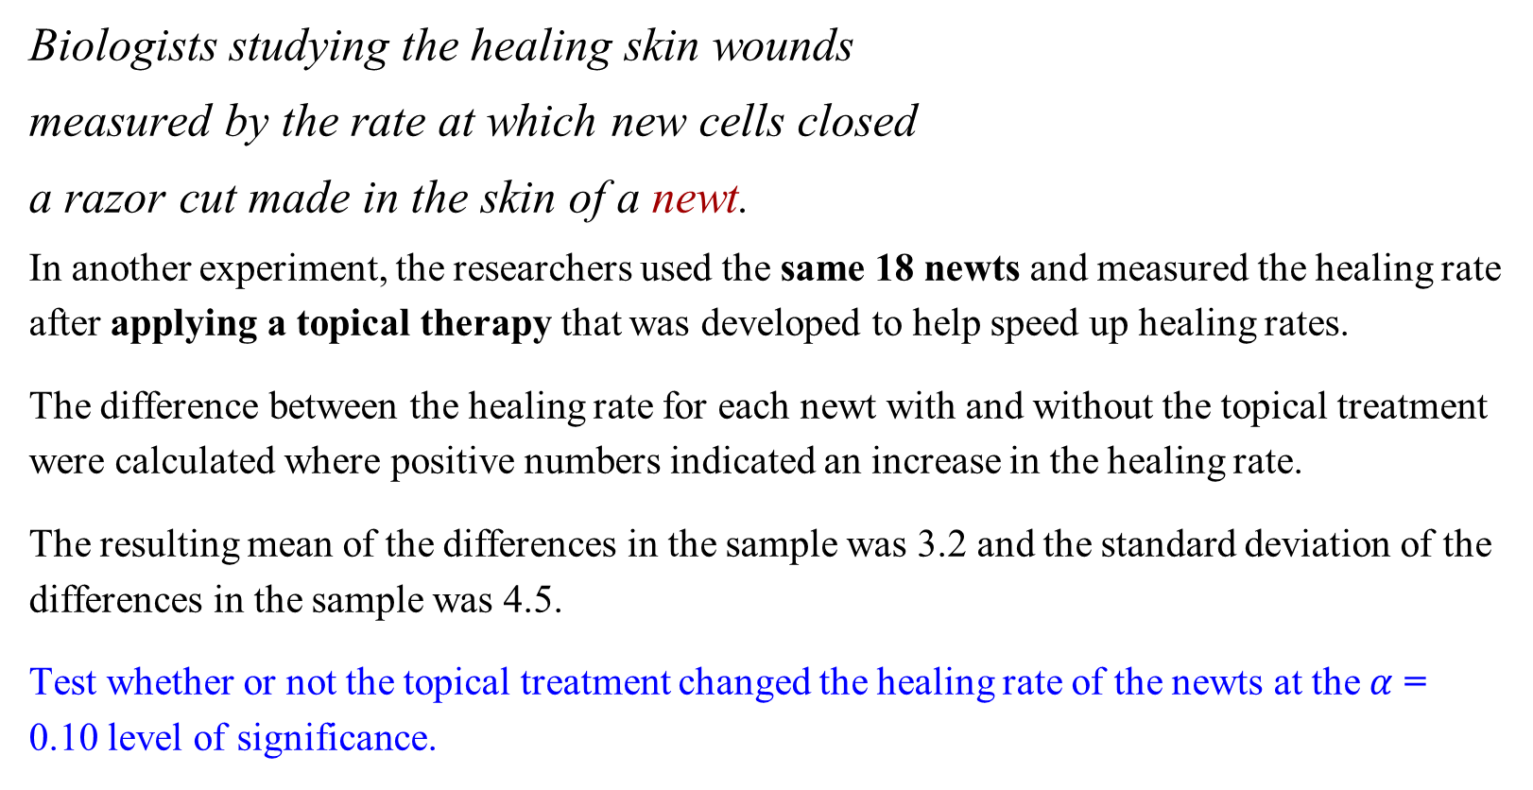
t-statistic – a two-sided example
Biologists studying the healing skin wounds
measured by the rate at which new cells closed
a razor cut made in the skin of a newt.
In another experiment, the researchers used the same 18 newts and measured the healing rate after applying a topical therapy that was developed to help speed up healing rates.
The difference between the healing rate for each newt with and without the topical treatment were calculated where positive numbers indicated an increase in the healing rate.
The resulting mean of the differences in the sample was 3.2 and the standard deviation of the differences in the sample was 4.5.
Test whether or not the topical treatment changed the healing rate of the newts at the $α$ = 0.10 level of significance.

Slide 17
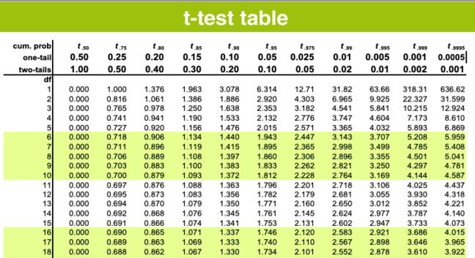
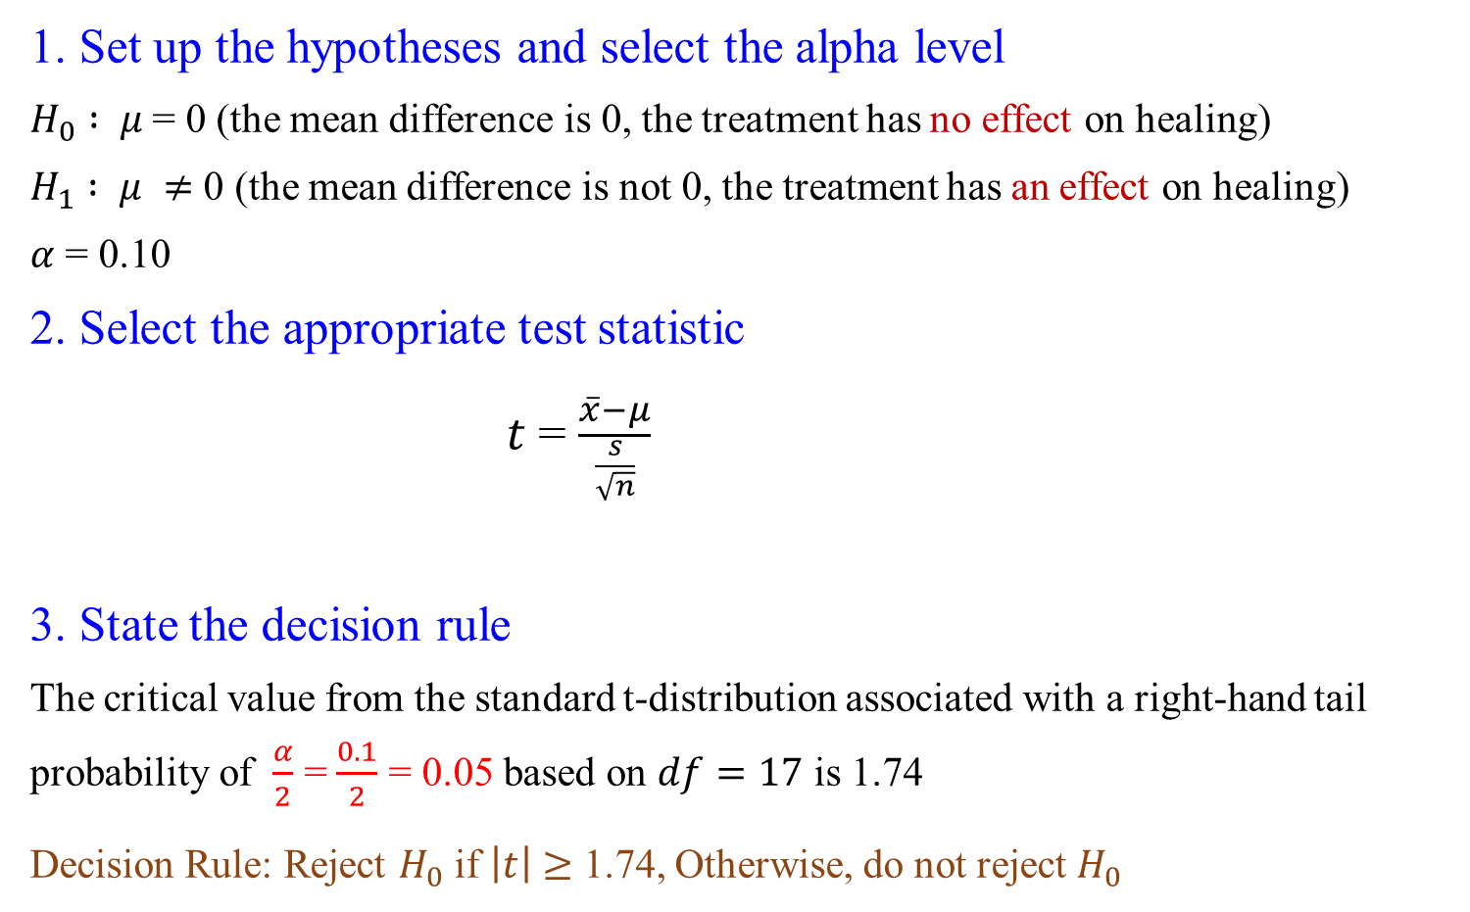
t-statistic – a two-sided example
1. Set up the hypotheses and select the alpha level
$H_{0} : μ$= 0 (the mean difference is 0, the treatment has no effect on healing)
$H_{1} : μ ≠$ 0 (the mean difference is not 0, the treatment has an effect on healing)
$α$ = 0.10
2. Select the appropriate test statistic
$t$ = $\frac{\overline{x}−μ}{\frac{s}{\sqrt{n}}}$
3. State the decision rule
The critical value from the standard t-distribution associated with a right-hand tail probability of $\frac{α}{2}$ = $\frac{0.1}{2}$ = 0.05 based on $df=17$ is 1.74
Decision Rule: Reject $H_{0}$ if $\left|t\right|$ $≥$ 1.74, Otherwise, do not reject $H_{0}$

Slide 18
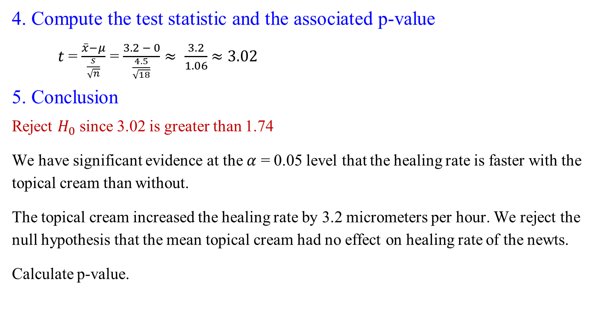
t-statistic – a two-sided example
4. Compute the test statistic and the associated p-value
$t$ = $\frac{\overline{x}−μ}{\frac{s}{\sqrt{n}}}$ = $\frac{3.2 − 0}{\frac{4.5}{\sqrt{18}}}$ $≈ \frac{3.2}{1.06}$ $≈3.02$
5. Conclusion
Reject $H_{0}$ since 3.02 is greater than 1.74
We have significant evidence at the $α$ = 0.05 level that the healing rate is faster with the topical cream than without.
The topical cream increased the healing rate by 3.2 micrometers per hour. We reject the null hypothesis that the mean topical cream had no effect on healing rate of the newts.
Calculate p-value.

Slide 19

t-statistic: a Two-sided Example - Calculate p-value
The t-statistic lies between the critical values for 0.005 and 0.0025, the p-value associated with the t-statistic of 3.02 is between 0.01 and 0.002 (since it is a two-sided test).

Slide 20
About the Above Example - Matched Pairs Design
Studies, where the same individual or experimental unit is given more than one treatment and the variable of interest, is the change between the treatments is called a matched pairs design.
We applied one-sample test procedures to analyze the observed differences.
1. either the one-sample z-test or
2. the one-sample t-test
Since two measurements are taken on the same observational unit in this type of design, the observations must first be compared, and the analysis needs to take place on the differences.

Slide 21
When t-test is Not Applicable
Note that the one-sample tests do not apply to the following situation:
It is essential to check the distribution of your sample data and check for strong skewness and outliers before you use t-procedures. If strong skewness exists or there are outliers present, using the t-procedures is not recommended (especially when using these procedures when n < 30)

Slide 22
Two-sample problems

Slide 23
Two-sample Problems
We are interested in comparing the distribution of the sample means from two populations
We have separate samples from each population, and we want to make conclusions about the characteristics of the two samples for a particular parameter
In the two-sample setting, one may be interested in comparing the centers (the means) or the spreads (the standard deviations) between the two populations
Two-sample tests for means are one of the most common problems in statistical practice. It is the focus of our course

Slide 24
Conditions to Use Two-sample Procedures
In the two-sample setting, conditions necessary for inference include:
1. Independence. Samples must be independent (not influencing each other) and randomly selected from the two distinct populations of interest
2. Same Measurement. The variable of interest must be measured in the same way in each of the populations.
3. Normal Distribution. The parameter of interest should be normally distributed (or at least have similar shapes and without outliers)

Slide 25

Notation Used for Two-sample Problems
We are interested in estimating $μ_{1}$ − $μ_{2}$ or testing the null hypothesis of no difference between means, $μ_{1}$ − $μ_{2}$= 0 or, $μ_{1}$ = $μ_{2}$.
${\overline{x}}_{1}$and ${\overline{x}}_{2}$estimate $μ_{1}$and $μ_{2}$
$s_{1}$and $s_{2}$ estimate $σ_{1}$ and $σ_{2}$

Slide 26
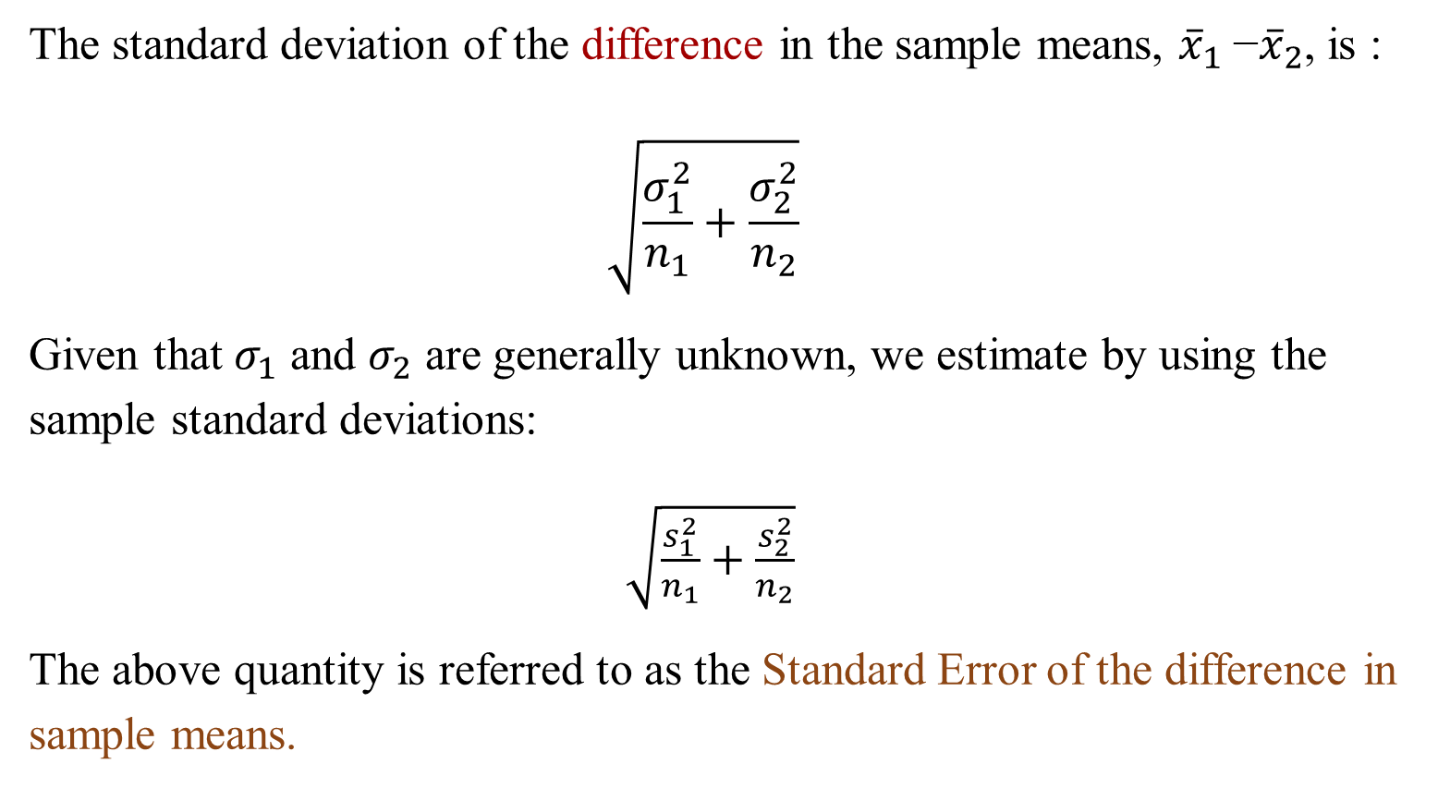
Two-sample Test of Means
The standard deviation of the difference in the sample means, ${\overline{x}}_{1}$−${\overline{x}}_{2}$, is :
$$\sqrt{\frac{σ_{1}^{2}}{n_{1}}+\frac{σ_{2}^{2}}{n_{2}}}$$
Given that $σ_{1}$ and $σ_{2}$ are generally unknown, we estimate by using the sample standard deviations:
$\sqrt{\frac{s_{1}^{2}}{n_{1}}+\frac{s_{2}^{2}}{n_{2}}}$
The above quantity is referred to as the Standard Error of the difference in sample means.

Slide 27
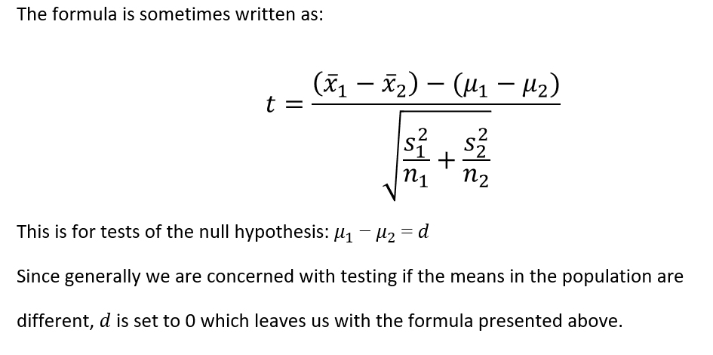
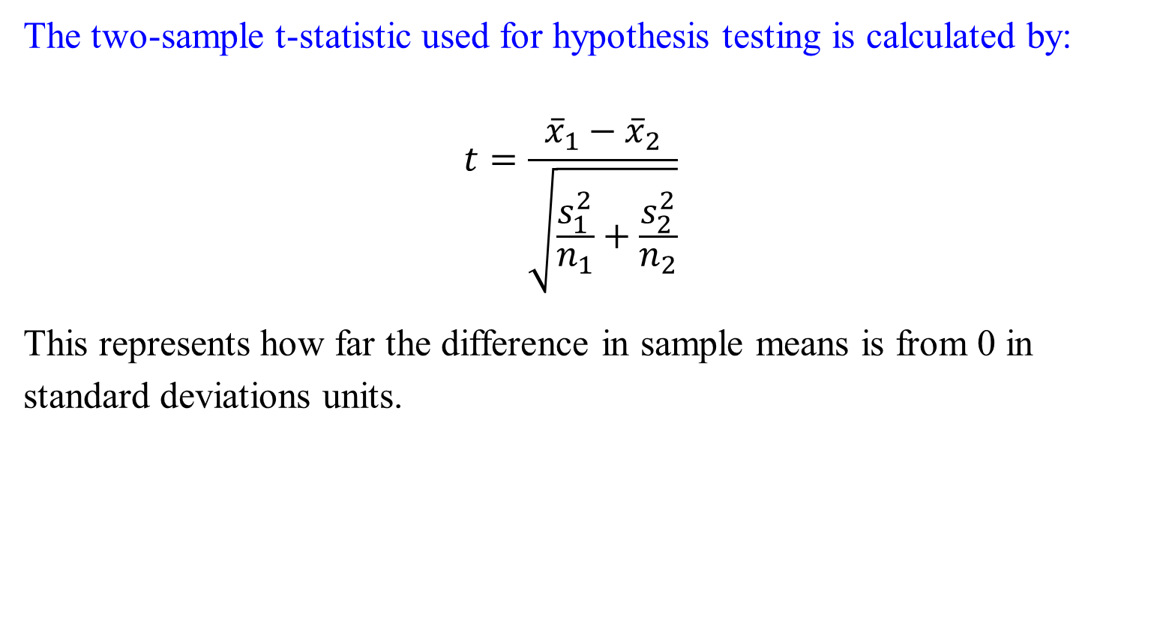
Two-sample Test of Means
The two-sample t-statistic used for hypothesis testing is calculated by:
$$t=\frac{{\overline{x}}_{1}−{\overline{x}}_{2}}{\sqrt{\frac{s_{1}^{2}}{n_{1}}+\frac{s_{2}^{2}}{n_{2}}}}$$
This represents how far the difference in sample means is from 0 in standard deviations units.
Notes:
$t$ = $\frac{\overline{x}−μ}{\frac{s}{\sqrt{n}}}$

Slide 28
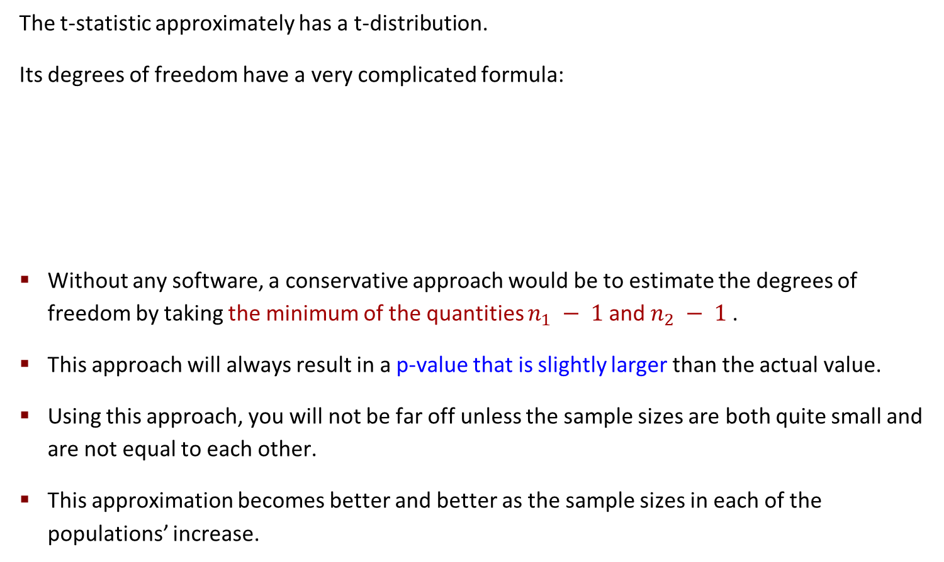
Two-sample Test: degree of freedom of t-distribution
The t-statistic approximately has a t-distribution.
Its degrees of freedom have a very complicated formula:
Without any software, a conservative approach would be to estimate the degrees of freedom by taking the minimum of the quantities $n_{1} − 1$and $n_{2} − 1$.
This approach will always result in a p-value that is slightly larger than the actual value.
Using this approach, you will not be far off unless the sample sizes are both quite small and are not equal to each other.
This approximation becomes better and better as the sample sizes in each of the populations’ increase.

Slide 29
Two-sample Test: An Example - Polyester Decay
How quickly do synthetic fabrics such as polyester decay in landfills?
In order to assess how quickly polyester decays over time in landfills, a researcher buried strips of the material in the soil for different lengths of time and then tested the force required to break them (as a measure of decay).

Slide 30
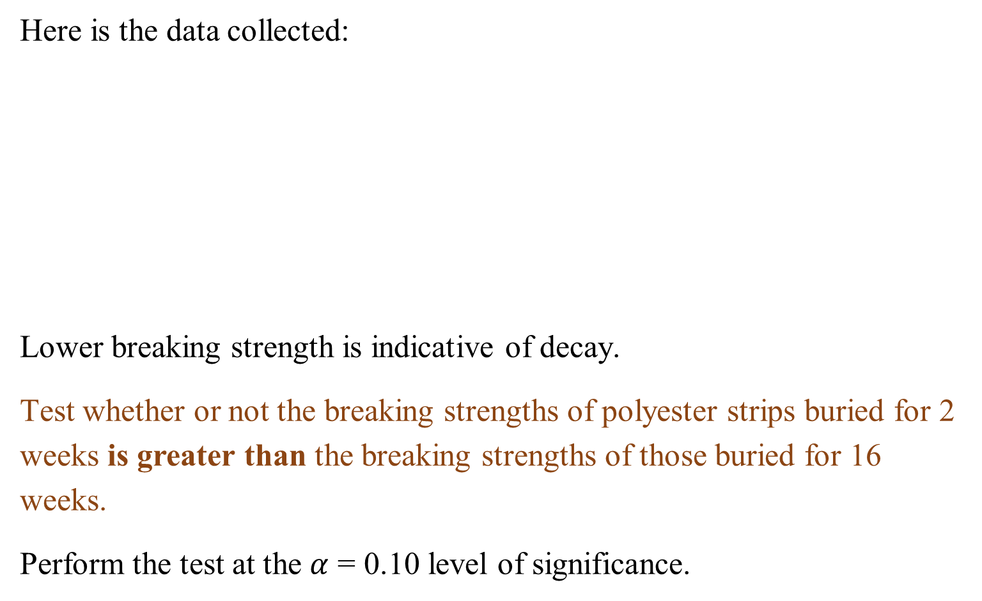
Two-sample Test: An Example
Here is the data collected:
Lower breaking strength is indicative of decay.
Test whether or not the breaking strengths of polyester strips buried for 2 weeks is greater than the breaking strengths of those buried for 16 weeks.
Perform the test at the $α$ = 0.10 level of significance.

Slide 31
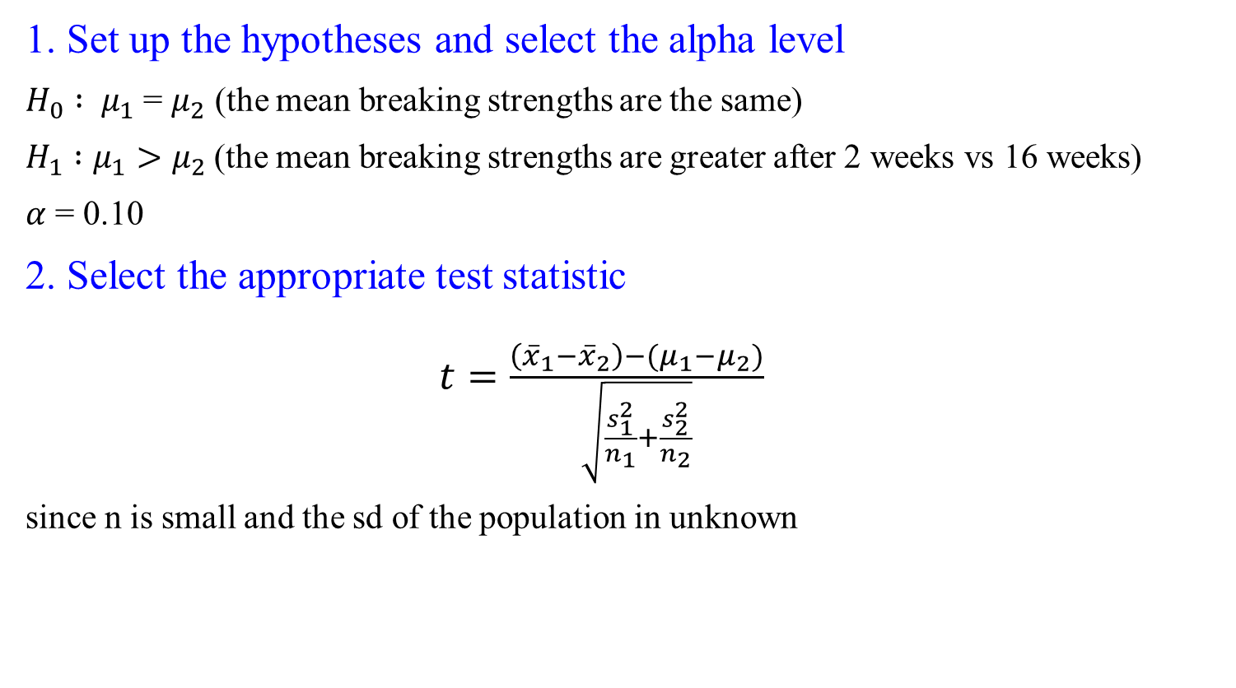
Example: Two-sample Test- Hypotheses Test
1. Set up the hypotheses and select the alpha level
$H_{0} : μ_{1}$= $μ_{2}$ (the mean breaking strengths are the same)
$H_{1} :μ_{1}>μ_{2}$(the mean breaking strengths are greater after 2 weeks vs 16 weeks)
$α$ = 0.10
2. Select the appropriate test statistic
$t=\frac{\left({\overline{x}}_{1}−{\overline{x}}_{2}\right)−(μ_{1}−μ_{2})}{\sqrt{\frac{s_{1}^{2}}{n_{1}}+\frac{s_{2}^{2}}{n_{2}}}}$
since n is small and the sd of the population in unknown

Slide 32
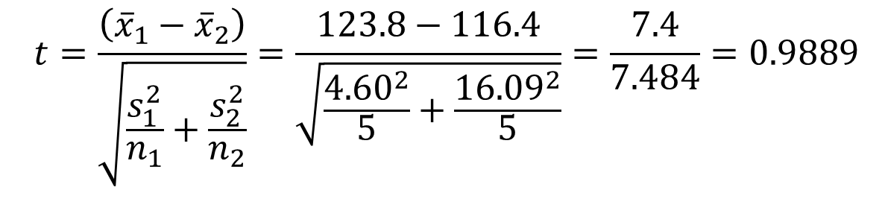
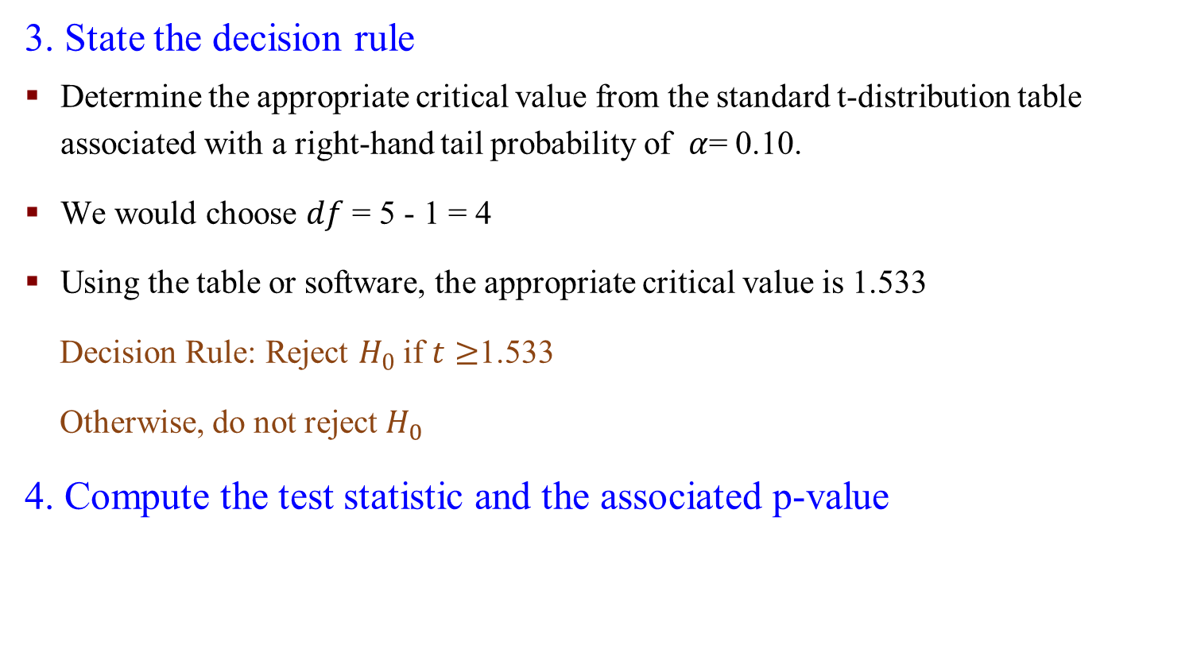
Example: Two-sample Test- Hypotheses Test
3. State the decision rule
Determine the appropriate critical value from the standard t-distribution table associated with a right-hand tail probability of $α$= 0.10.
We would choose $df$ = 5 - 1 = 4
Using the table or software, the appropriate critical value is 1.533
Decision Rule: Reject $H_{0}$ if $t≥$1.533
Otherwise, do not reject $H_{0}$
4. Compute the test statistic and the associated p-value
$$t=\frac{\left({\overline{x}}_{1}−{\overline{x}}_{2}\right)}{\sqrt{\frac{s_{1}^{2}}{n_{1}}+\frac{s_{2}^{2}}{n_{2}}}}=\frac{123.8−116.4}{\sqrt{\frac{{4.60}^{2}}{5}+\frac{{16.09}^{2}}{5}}}=\frac{7.4}{7.484}=0.9889$$

Slide 33

Example: Two-sample Test- Hypotheses Test
5. Conclusion
Fail to reject $H_{0}$ since 0.9889 is less than 1.53
We do not have significant evidence at the $α$= 0.10 level to conclude that polyester decays more in 2 weeks than in 16 weeks

Slide 34
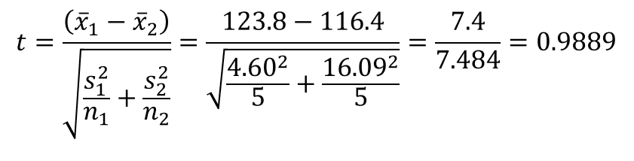


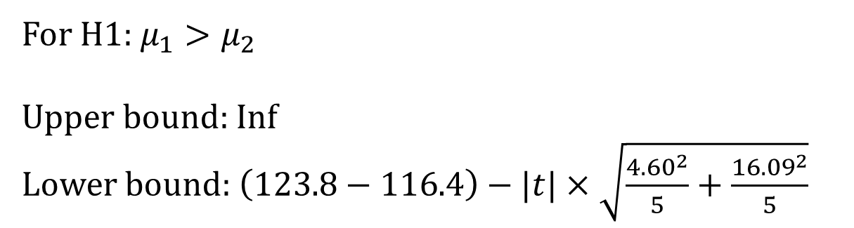
Two-Sample Confidence Interval for Comparison of Means
The confidence interval for the difference in population means is:
$\left({\overline{x}}_{1}−{\overline{x}}_{2}\right)±t×$ $\sqrt{\frac{s_{1}^{2}}{n_{1}}+\frac{s_{2}^{2}}{n_{2}}}$
Confidence intervals are typical of the form:
estimate ± critical value$×{SE}_{estimate}$
For H1: $μ_{1}>μ_{2}$
Upper bound: Inf
Lower bound: $\left(123.8−116.4\right)−|t|×$ $\sqrt{\frac{{4.60}^{2}}{5}+\frac{{16.09}^{2}}{5}}$

Slide 35
R commands – Two-sample t-test
Be careful: for one-sided tests, the order in which you put x and y matters!

Slide 36
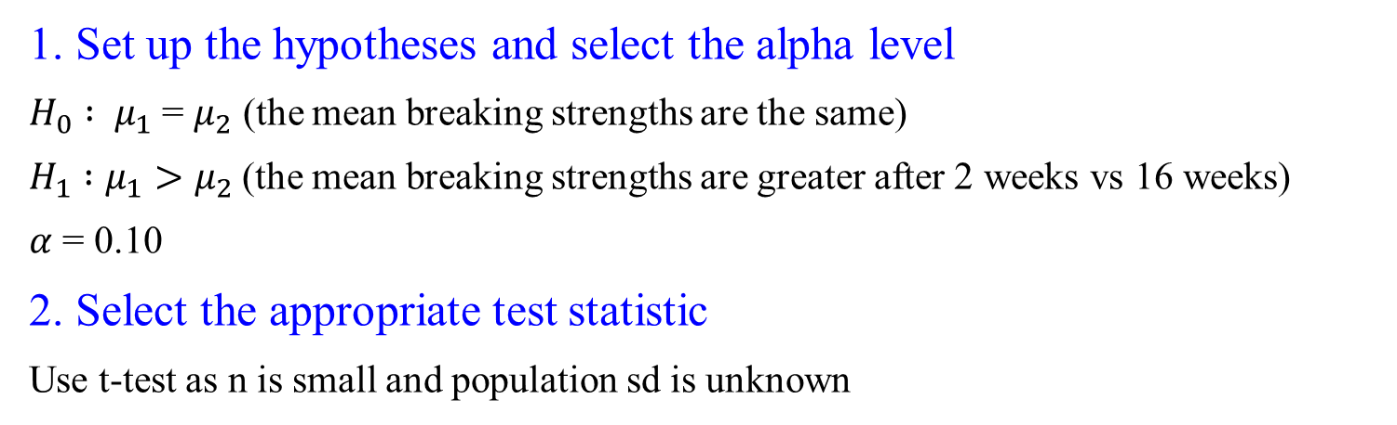
Two-sample Test: An Example - Polyester Decay
1. Set up the hypotheses and select the alpha level
$H_{0} : μ_{1}$= $μ_{2}$ (the mean breaking strengths are the same)
$H_{1} :μ_{1}>μ_{2}$(the mean breaking strengths are greater after 2 weeks vs 16 weeks)
$α$ = 0.10
2. Select the appropriate test statistic
Use t-test as n is small and population sd is unknown

Slide 37
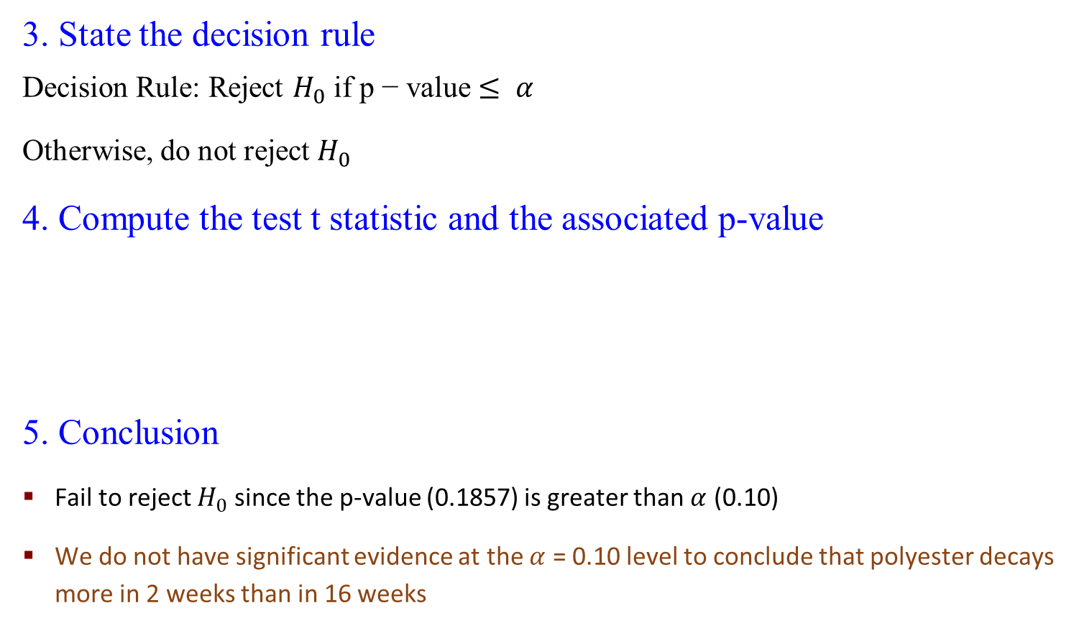
Two-sample Test: An Example - Polyester Decay
3. State the decision rule
Decision Rule: Reject $H_{0}$ if p − value $≤ α$
Otherwise, do not reject $H_{0}$
4. Compute the test t statistic and the associated p-value
5. Conclusion
Fail to reject $H_{0}$ since the p-value (0.1857) is greater than $α$ (0.10)
We do not have significant evidence at the $α$ = 0.10 level to conclude that polyester decays more in 2 weeks than in 16 weeks

Slide 38
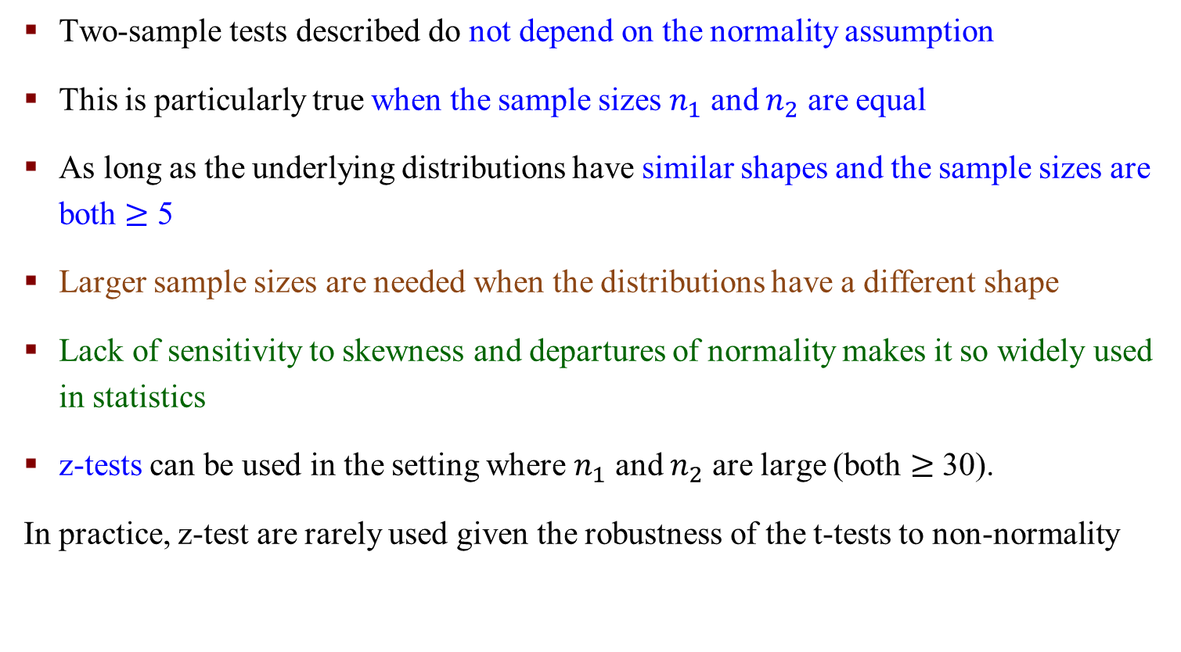
Closing Remarks
Two-sample tests described do not depend on the normality assumption
This is particularly true when the sample sizes $n_{1}$ and $n_{2}$ are equal
As long as the underlying distributions have similar shapes and the sample sizes are both $≥$ 5
Larger sample sizes are needed when the distributions have a different shape
Lack of sensitivity to skewness and departures of normality makes it so widely used in statistics
z-tests can be used in the setting where $n_{1}$ and $n_{2}$ are large (both $≥$ 30).
In practice, z-test are rarely used given the robustness of the t-tests to non-normality

